Slide 1
Go-based IoT with Gobot
Trevor Rosen

Slide 2

“The Internet of things (IoT) is the network of physical devices, vehicles, home appliances, and other items embedded with electronics, software, sensors, actuators, and network connectivity which enable these objects to connect and exchange data.”
Wikipedia
Innovate Summit 2017
Notes:
Estimates of the number of IoT devices deployed (and the rate at which that number is growing) vary widely, but it’s safe to say that there will be around 10 billion IoT devices deployed worldwide by 2020.

Slide 3
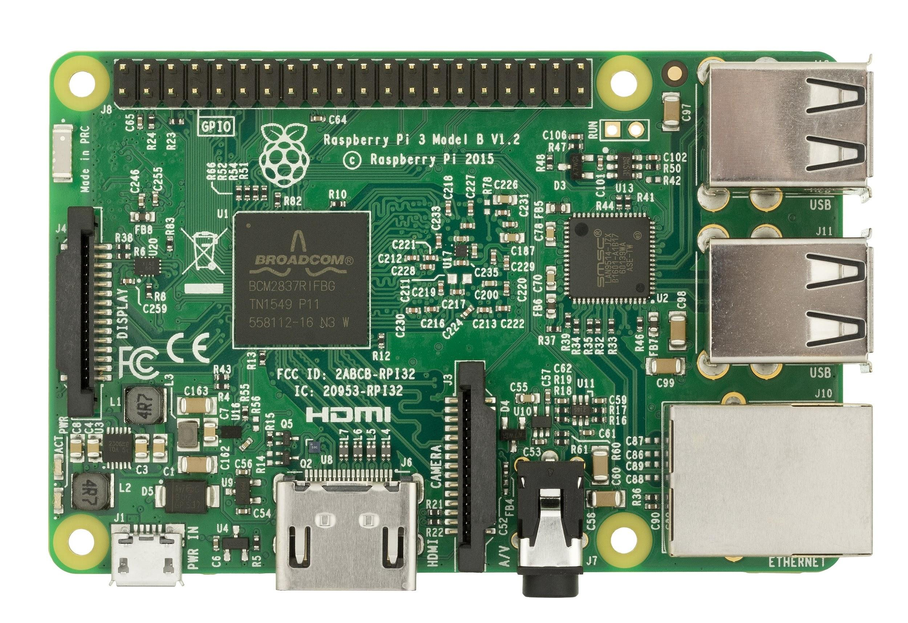
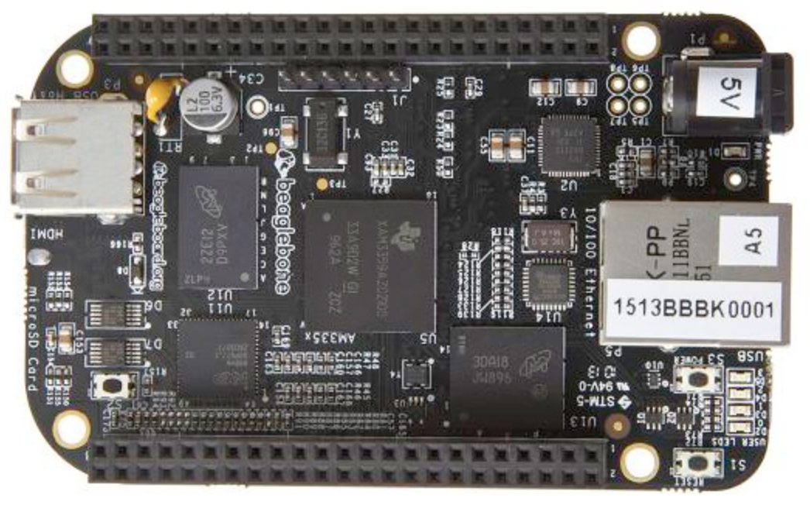
Single-board computers
Low-cost
Relatively powerful
Run full versions of Linux
Wifi, Bluetooth, HDMI, SDcard
Multi-gig persistent storage
512MB RAM or better
ARM chips at 1ghz or better
Good for prototyping
GPIO, analog, I2C
Useful in a wide variety of applications
Innovate Summit 2017
Images from Wikipedia
Notes:
In the past 7 or 8 years we’ve seen a dizzying array of single-board computers released. Capabilities vary but all allow controlling of low-level electronic components in various ways.

Slide 4
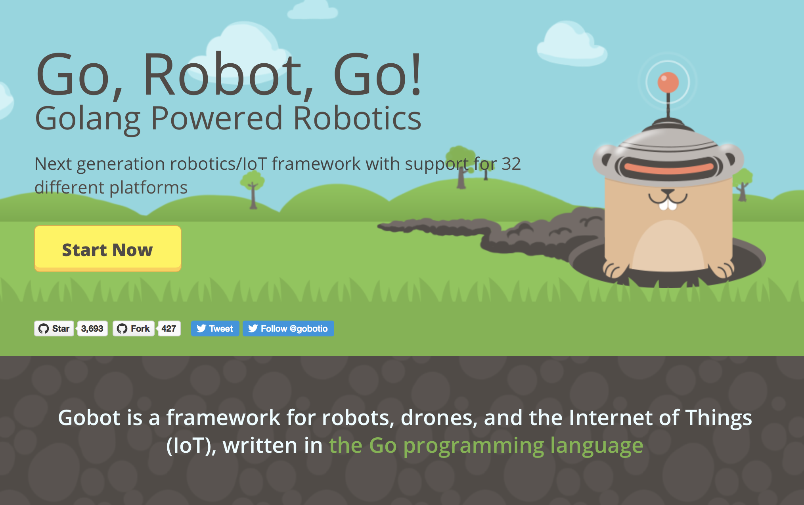
https://gobot.io
Innovate Summit 2017
Notes:
Go computer language is a systems language from Google. Produces static binaries. Is garbage collected and contains a full thread multiplexing runtime. Not appropriate for cases where you have an available space for firmware measured in kilobytes, but great in environments with more resources.

Slide 5
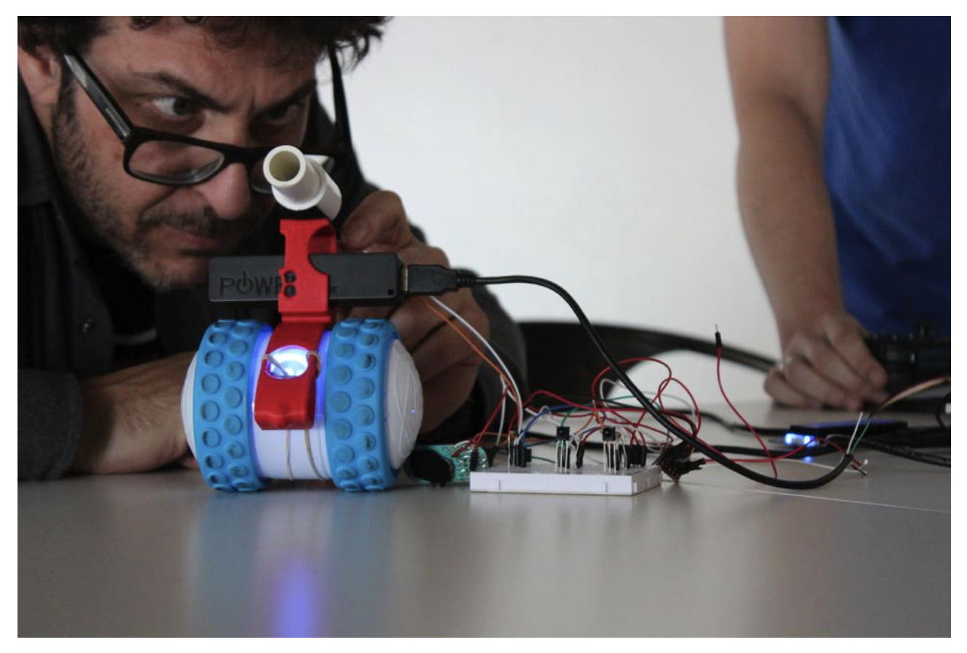
Abstractions for toys, busses, boards
32 supported platforms
Common single-boards
Toys such as Sphero, ARDrone, Bebop
Human-computer interface stuff Neurosky and LeapMotion
Bluetooth LE
Drivers for GPIO, analog, I2C
“Robot” abstraction is a software construct that can be given work to do. Leverages Go interfaces to give any project a common rudimentary command set.
HTTP API for controlling Robots
Ron Evans, Gobot maintainer
Source: Vice.com
Innovate Summit 2017

Slide 6
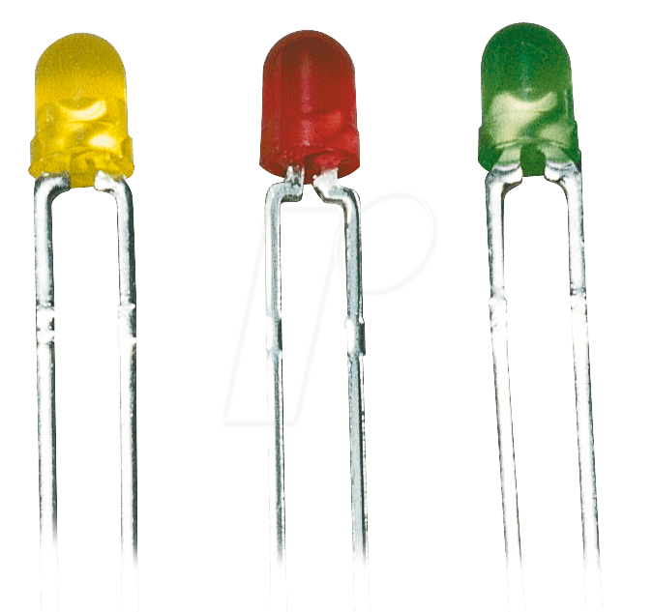

Gobot HTTP API
Perform function
HTTP handler
gobot.Robot.Run()
Innovate Summit 2017
Notes:
You can make a Gobot Robot interactive by leveraging the HTTP API as a web server running on your single board.

Slide 7
Demo Code
package main
import (
"time"
"github.com/hybridgroup/gobot/platforms/gpio"
"github.com/hybridgroup/gobot/platforms/intel-iot/edison"
)
func main() {
e := edison.NewEdisonAdaptor("edison")
ticker := time.NewTicker(time.Millisecond * 500)
greenLed := gpio.NewLedDriver(e, "led", "2")
for t := range ticker.C {
greenLed.Toggle()
}
}
Initialize an
Edison adapter
Use LED driver and abstraction
Innovate Summit 2017
Notes:
Blinking an LED is the hello world of electronics development. You could do this in Python pretty easily as well, but then you’d be stuck actually installing a dependency set on the board, and who wants to have to do that when you can just scp your working binary?

Slide 8
The SolarWinds and SolarWinds Cloud trademarks are the exclusive property of SolarWinds Worldwide, LLC and its affiliates and may be registered or pending registration with the U.S. Patent and Trademark Office and in other countries. All other SolarWinds and SolarWinds Cloud trademarks, service marks, and logos may be common law marks or are registered or pending registration. All other trademarks mentioned herein are used for identification purposes only and are trademarks (and may be registered trademarks) of their respective companies.

